Slide 1
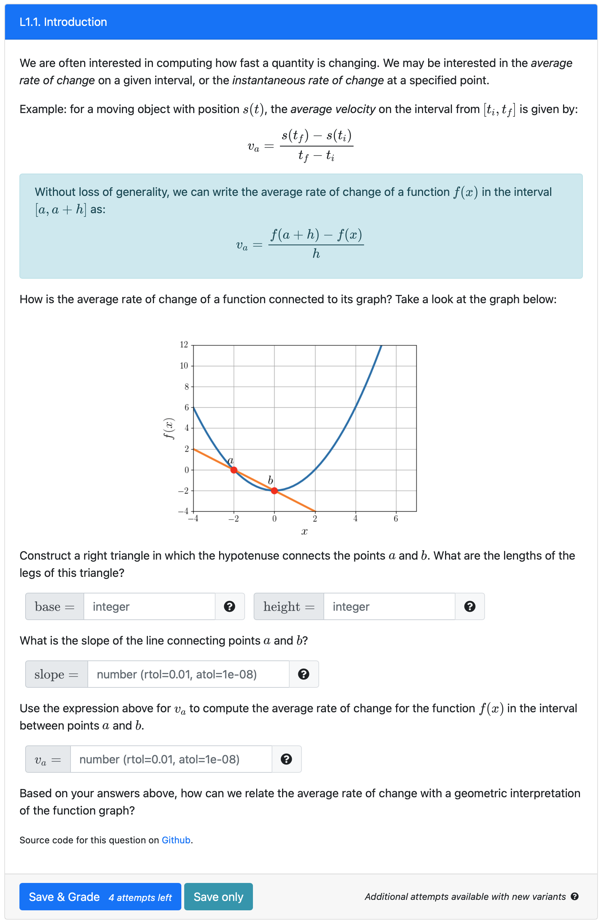
Text (html or markdown) and equations using Latex
Figures (this plot is dynamically generated using python library, but one can also include static images)
PrairieLearn elements

Slide 2
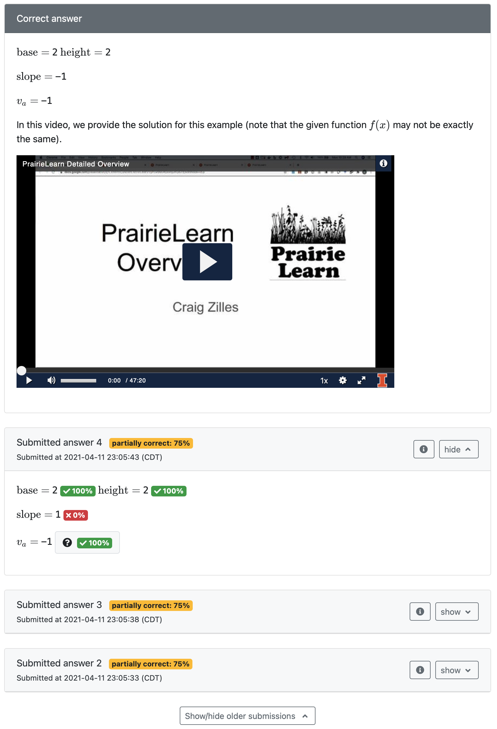
Correct answer is only displayed after all attempts for the variant are used, or the question is answered correctly. In this example, we embed a short video explaining the solution
Log of all submissions

Slide 3
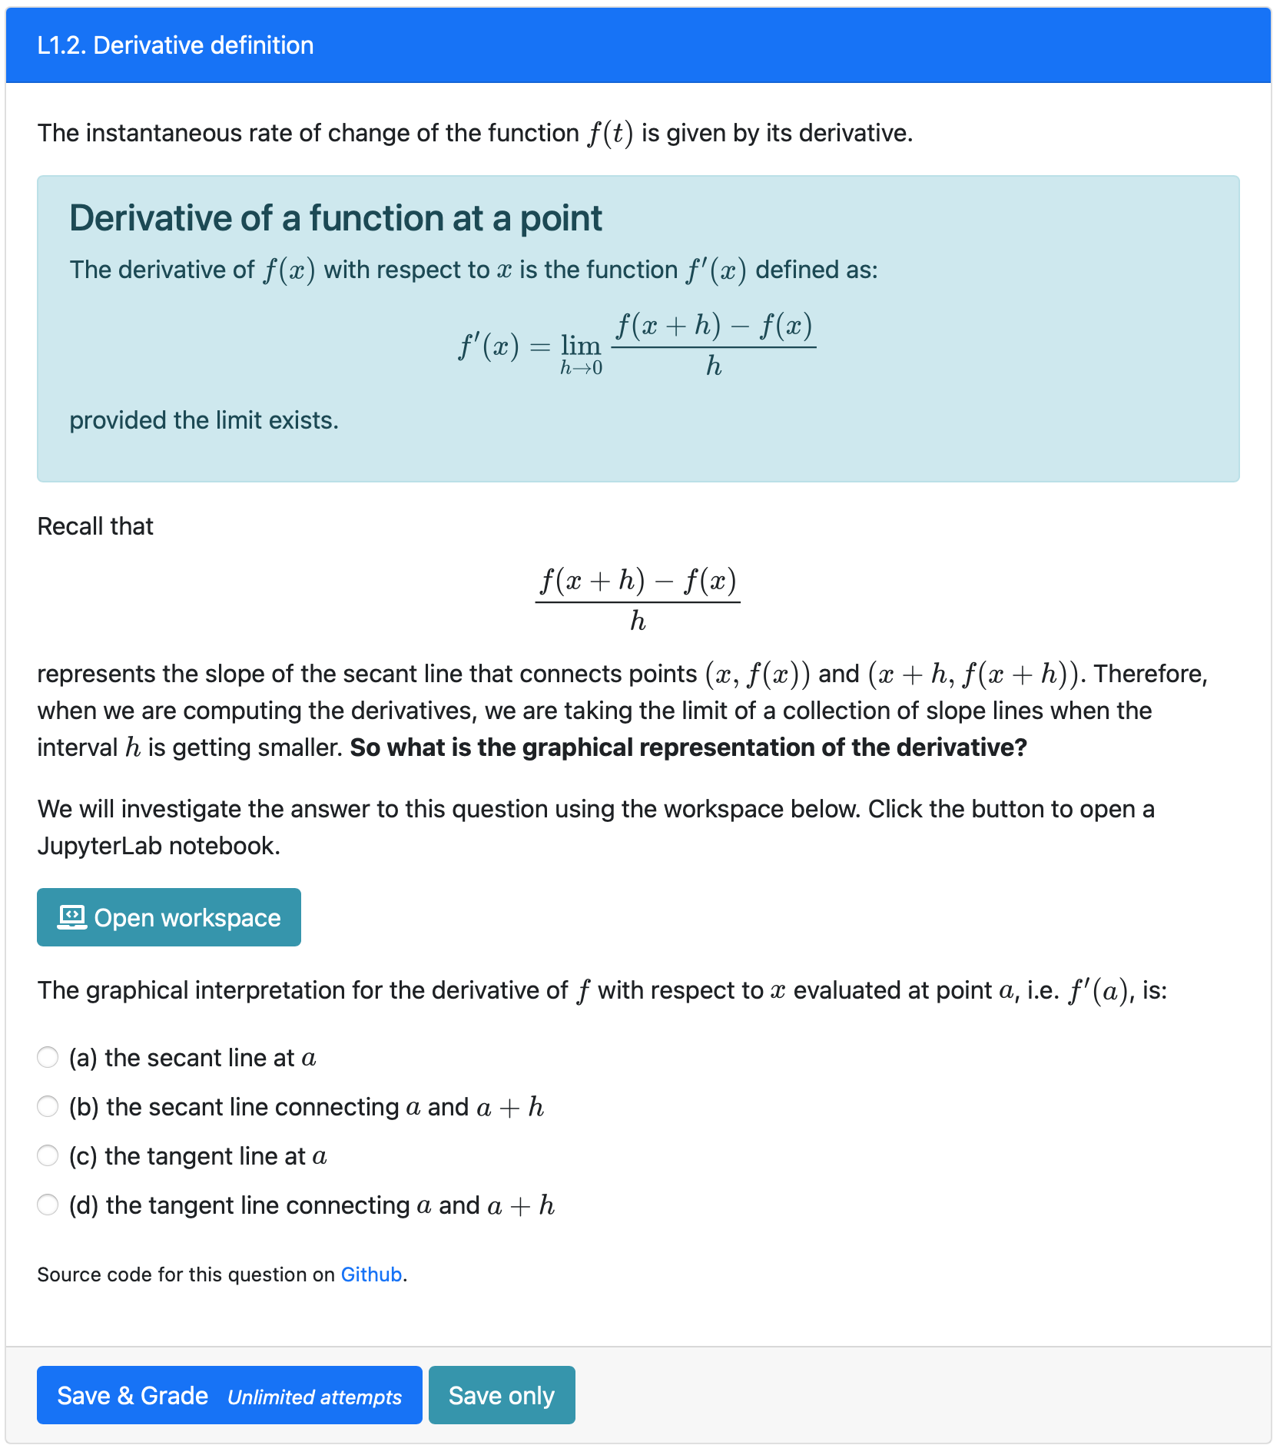
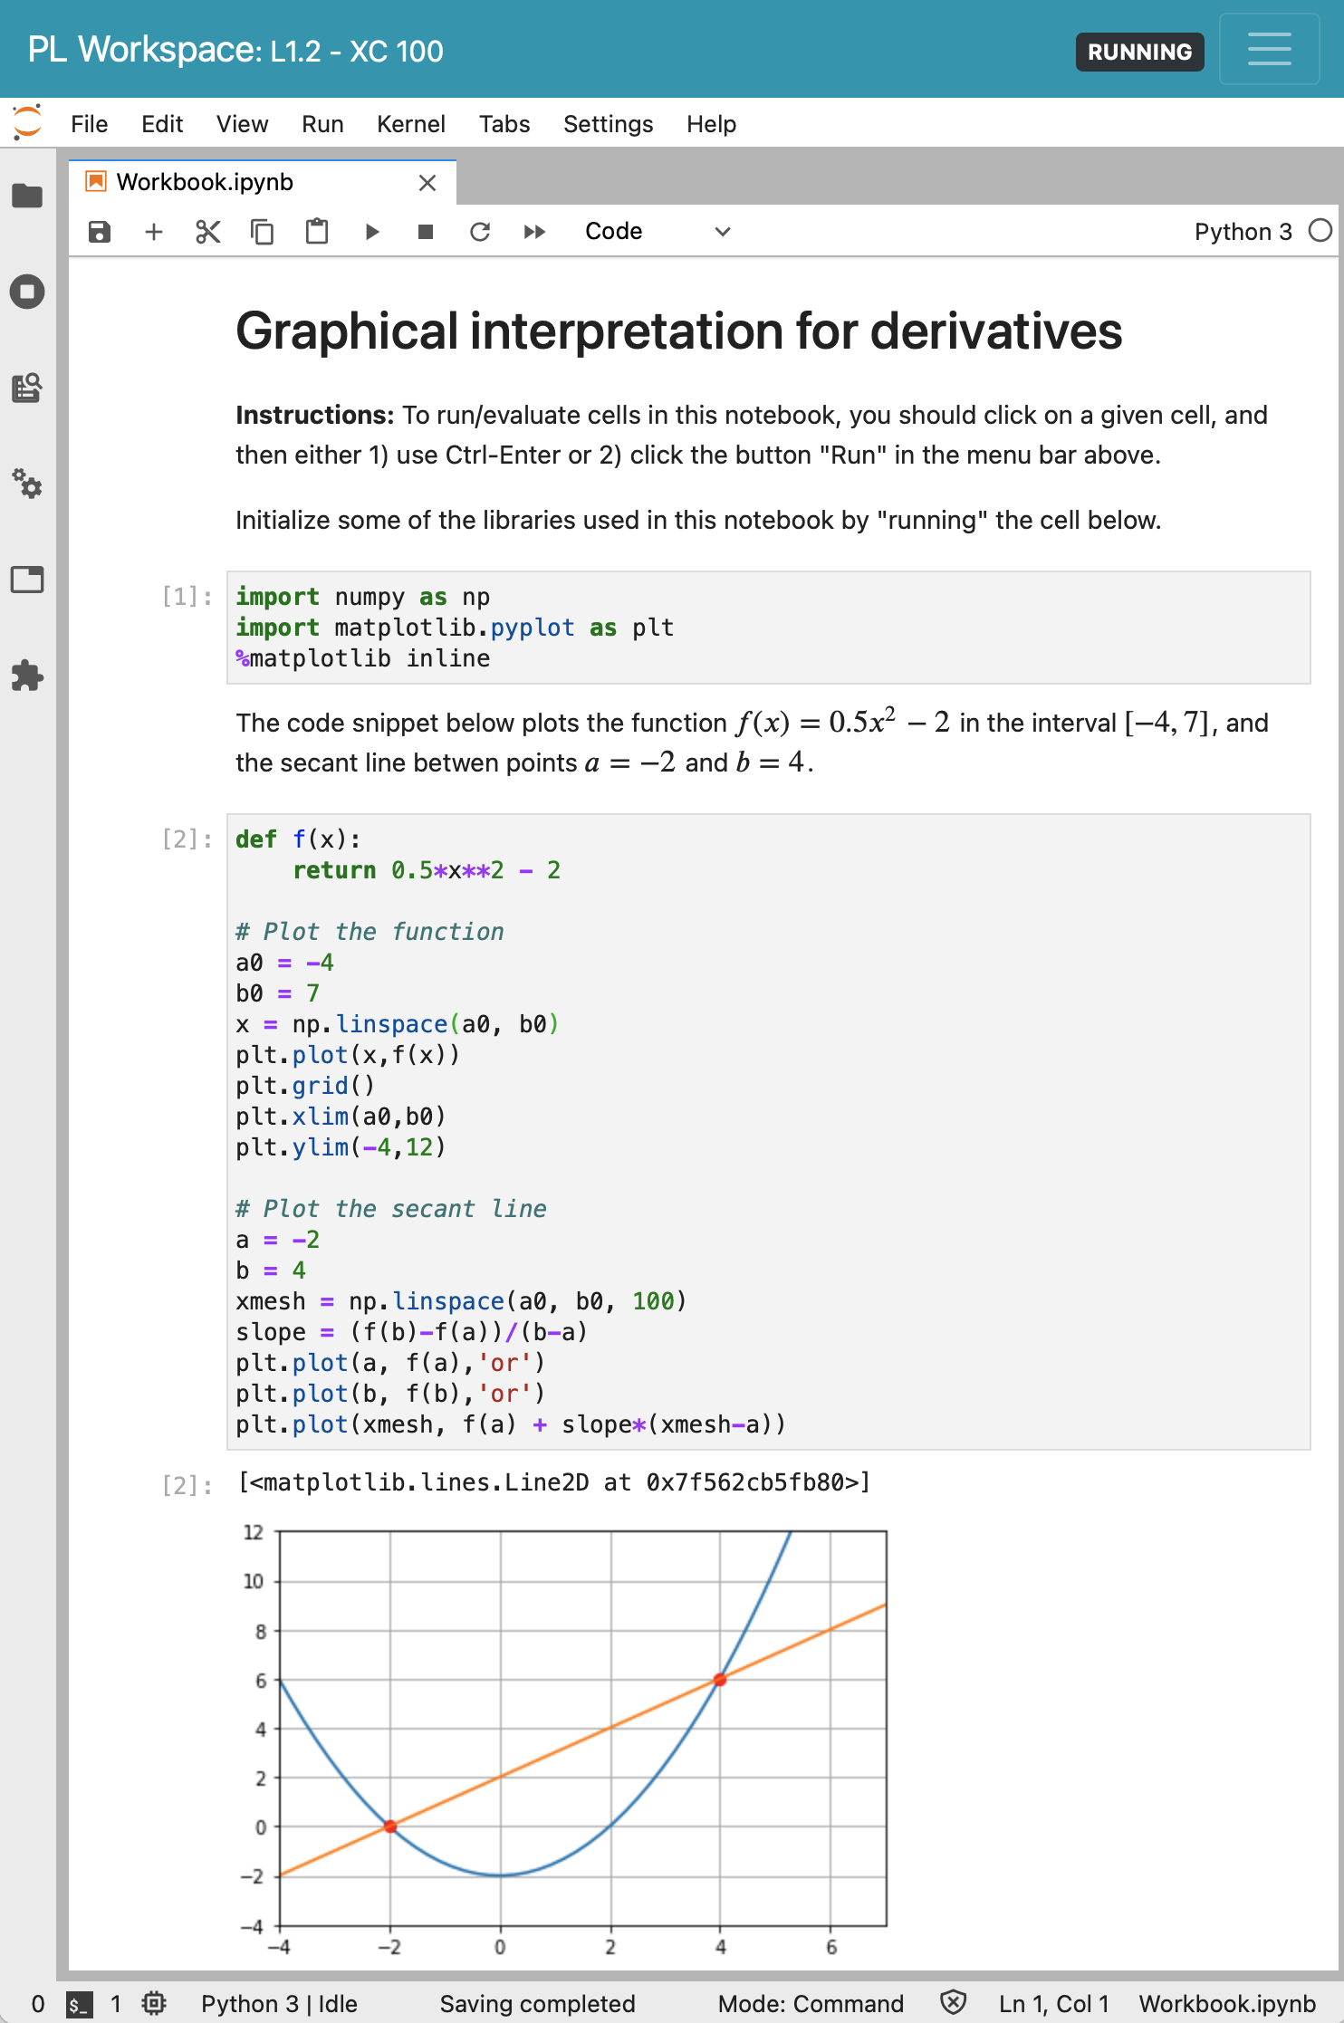
Opens JupyterLab
PrairieLearn element

Slide 4
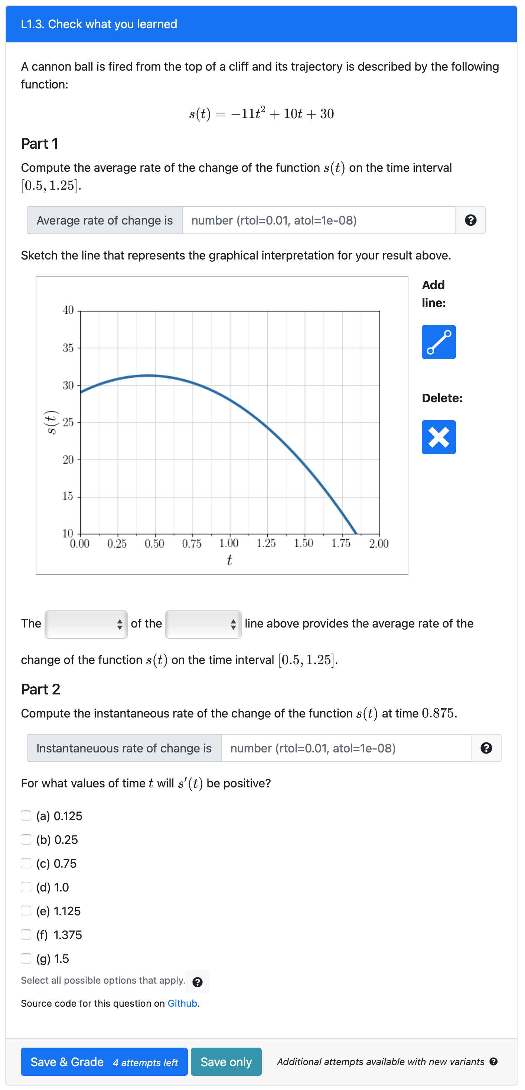
These parameters are randomized for each question variant
Number input
Sketch input
Plot is dynamically generated based on the parameters above.
Dropdown input
Number input
These parameters are randomized for each question variant
Checkbox input

Slide 5
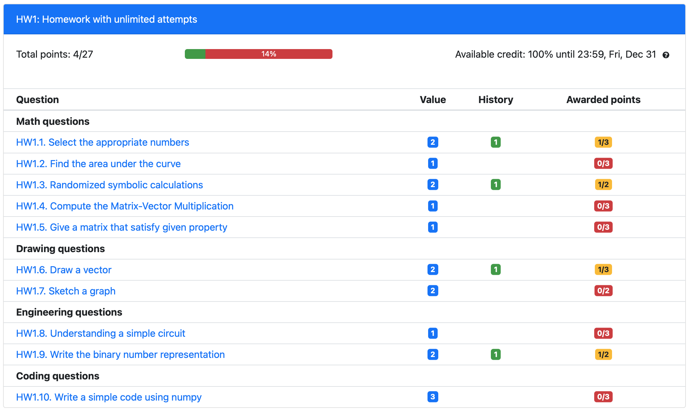
Checkbox input

Slide 6
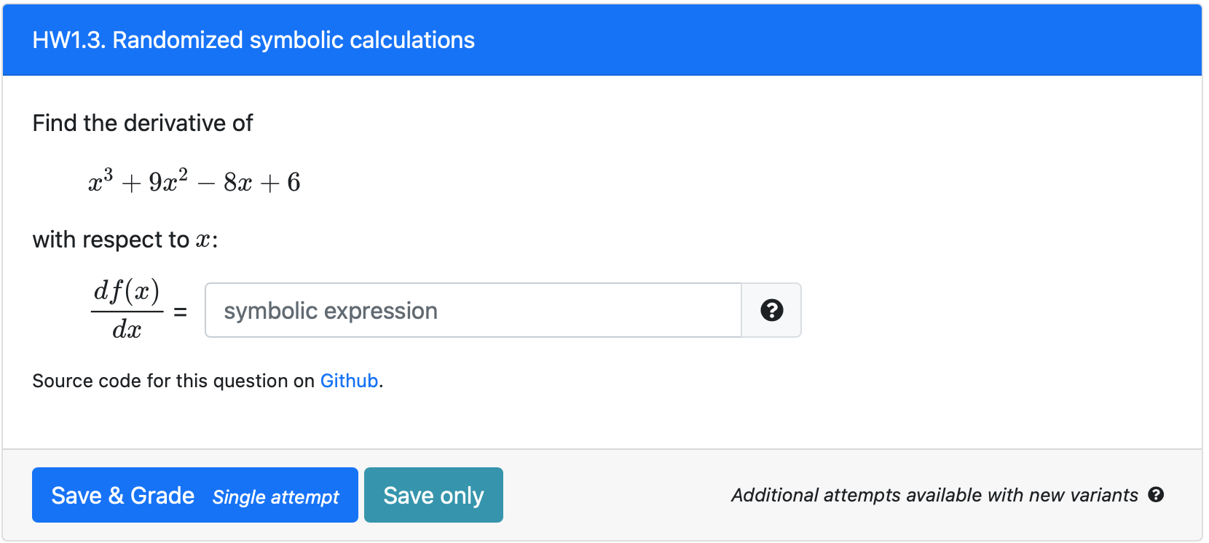
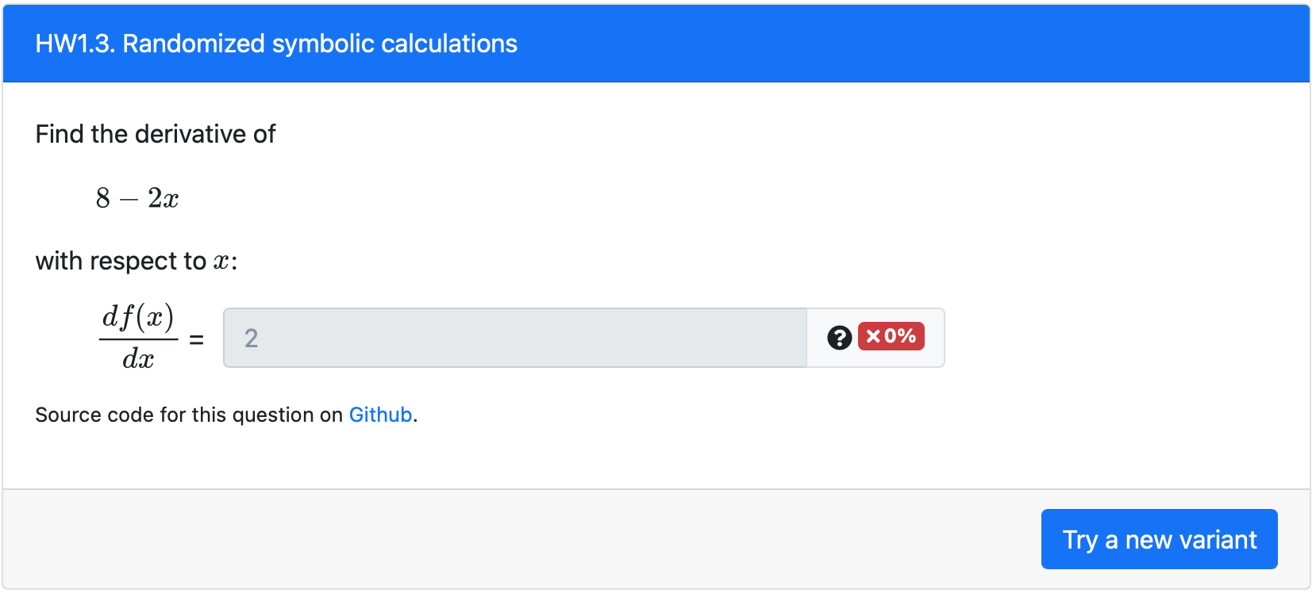
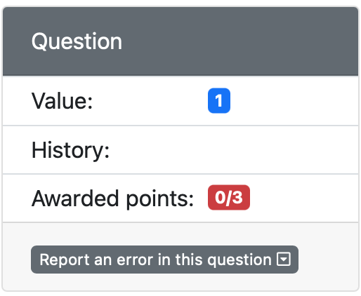
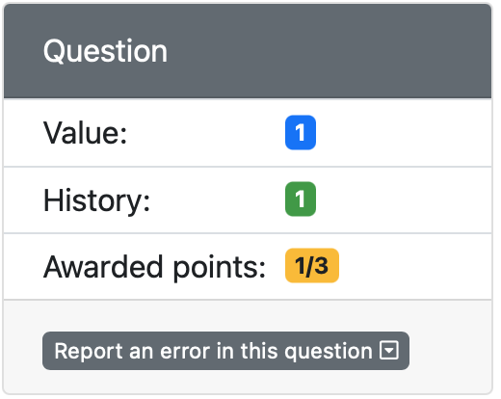
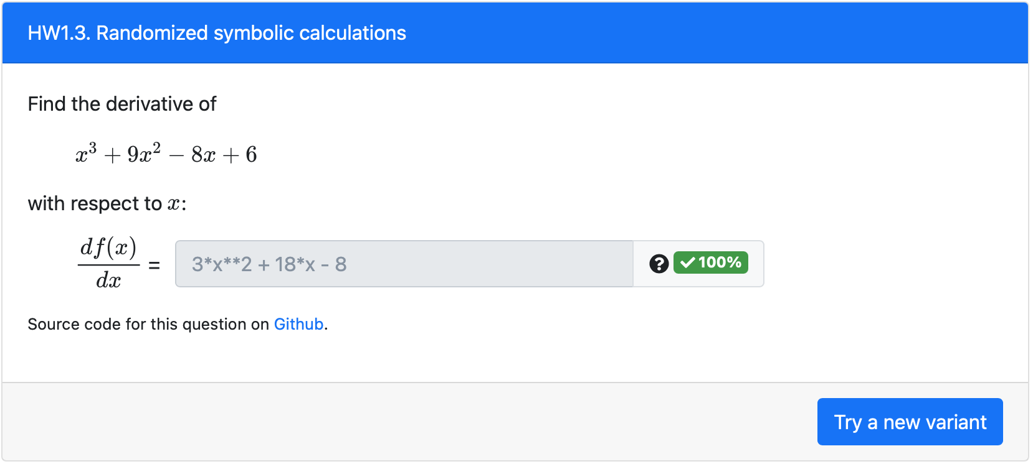
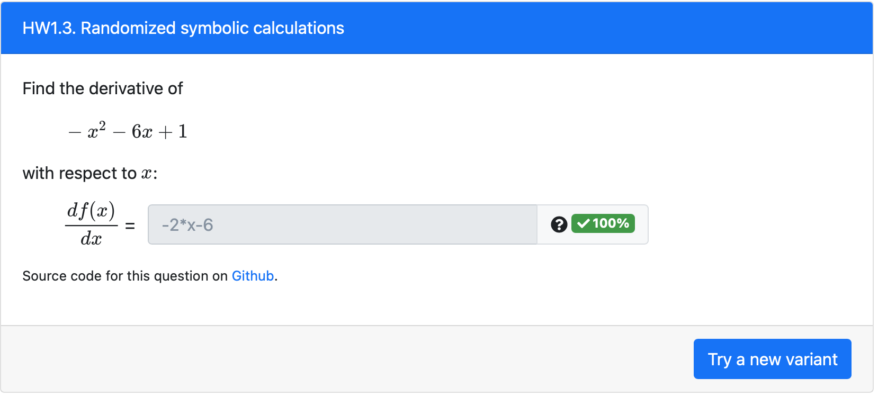

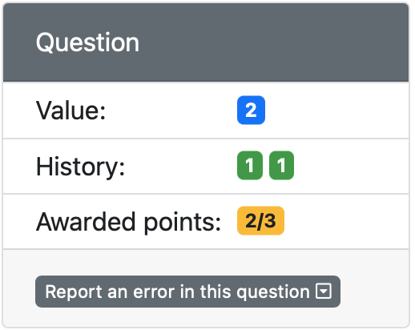
Fig. A) Initial configuration
Fig. C) After 2nd attempt
points
maxPoints
Fig. B) After 1st attempt
Fig. D) After 3rd attempt

Slide 7
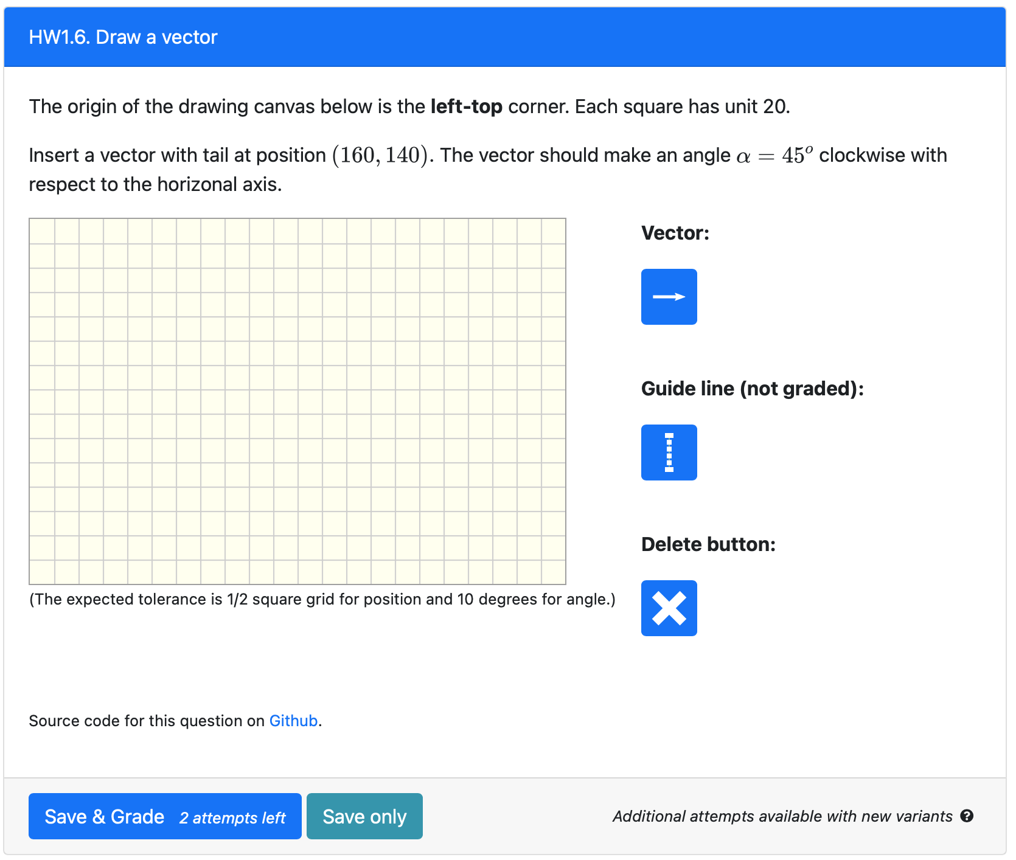
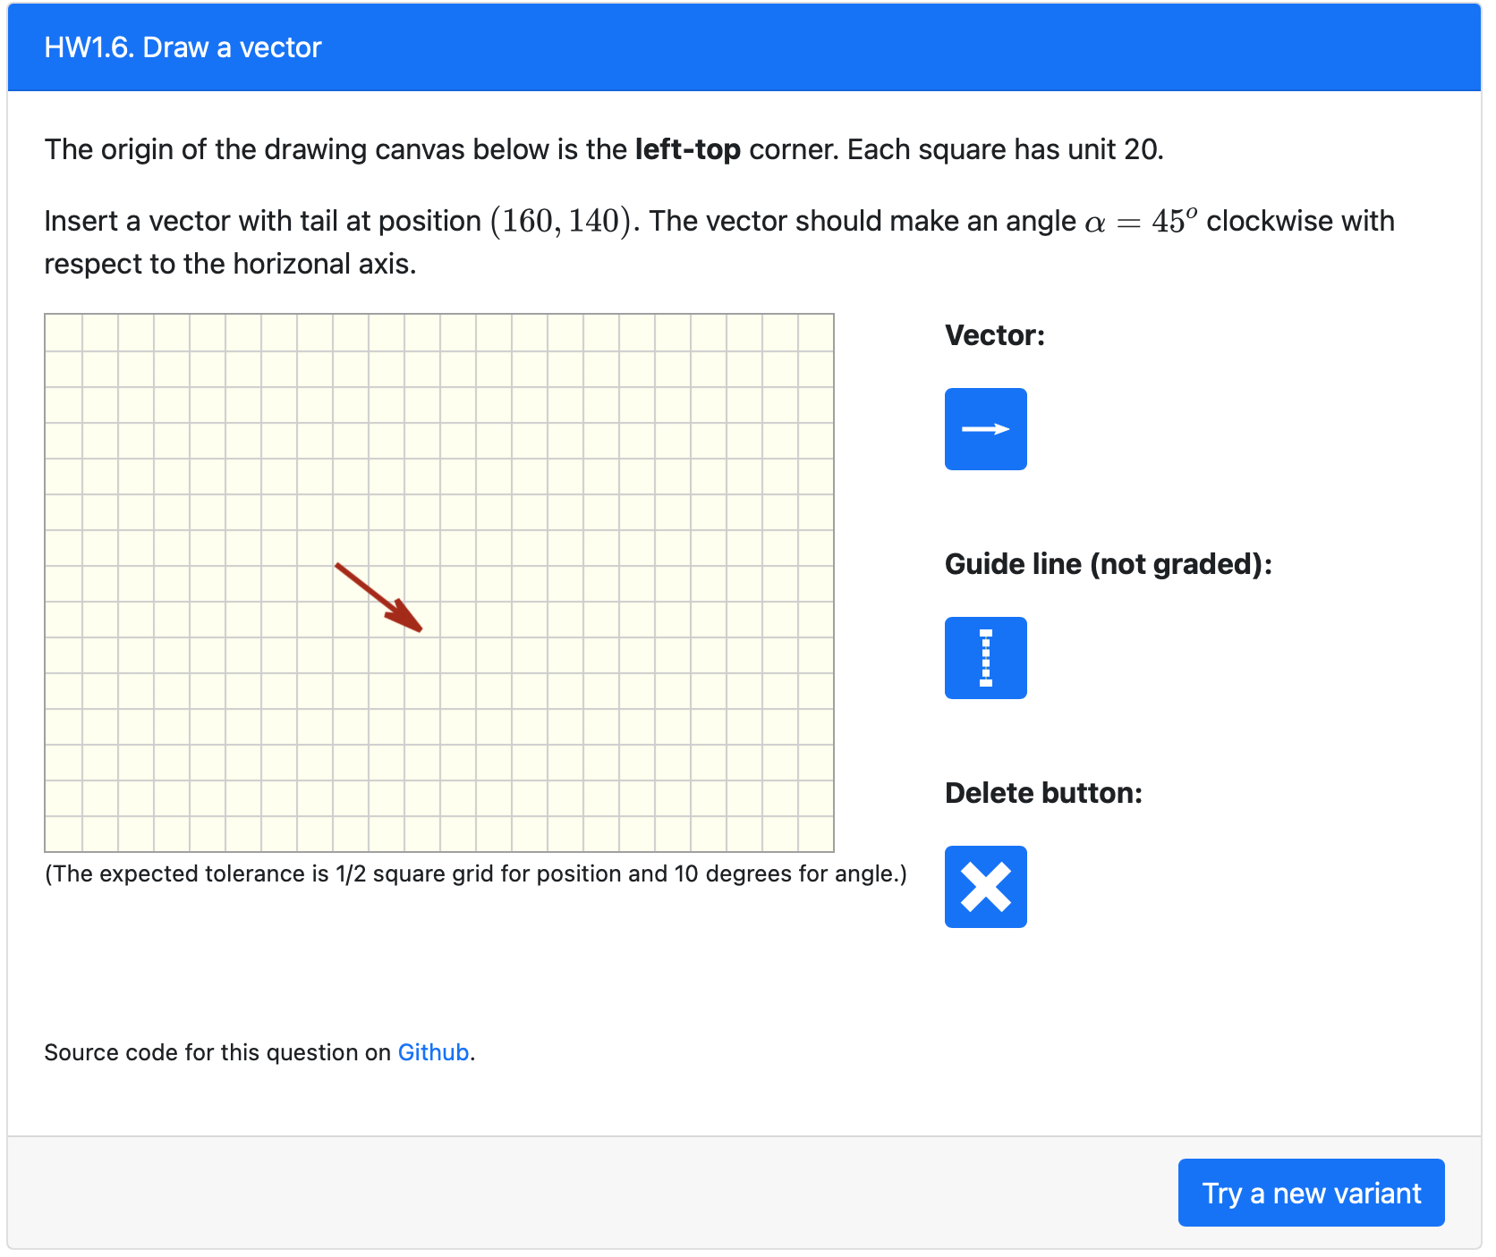
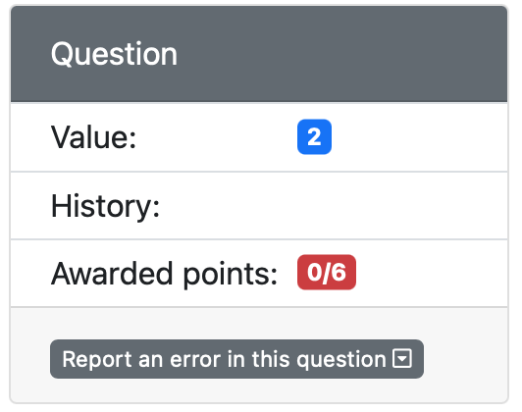
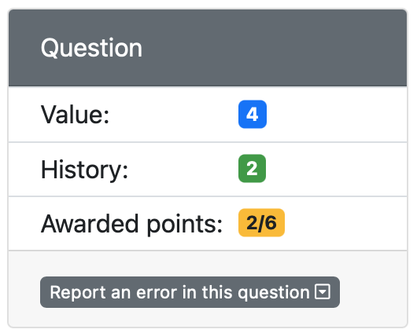
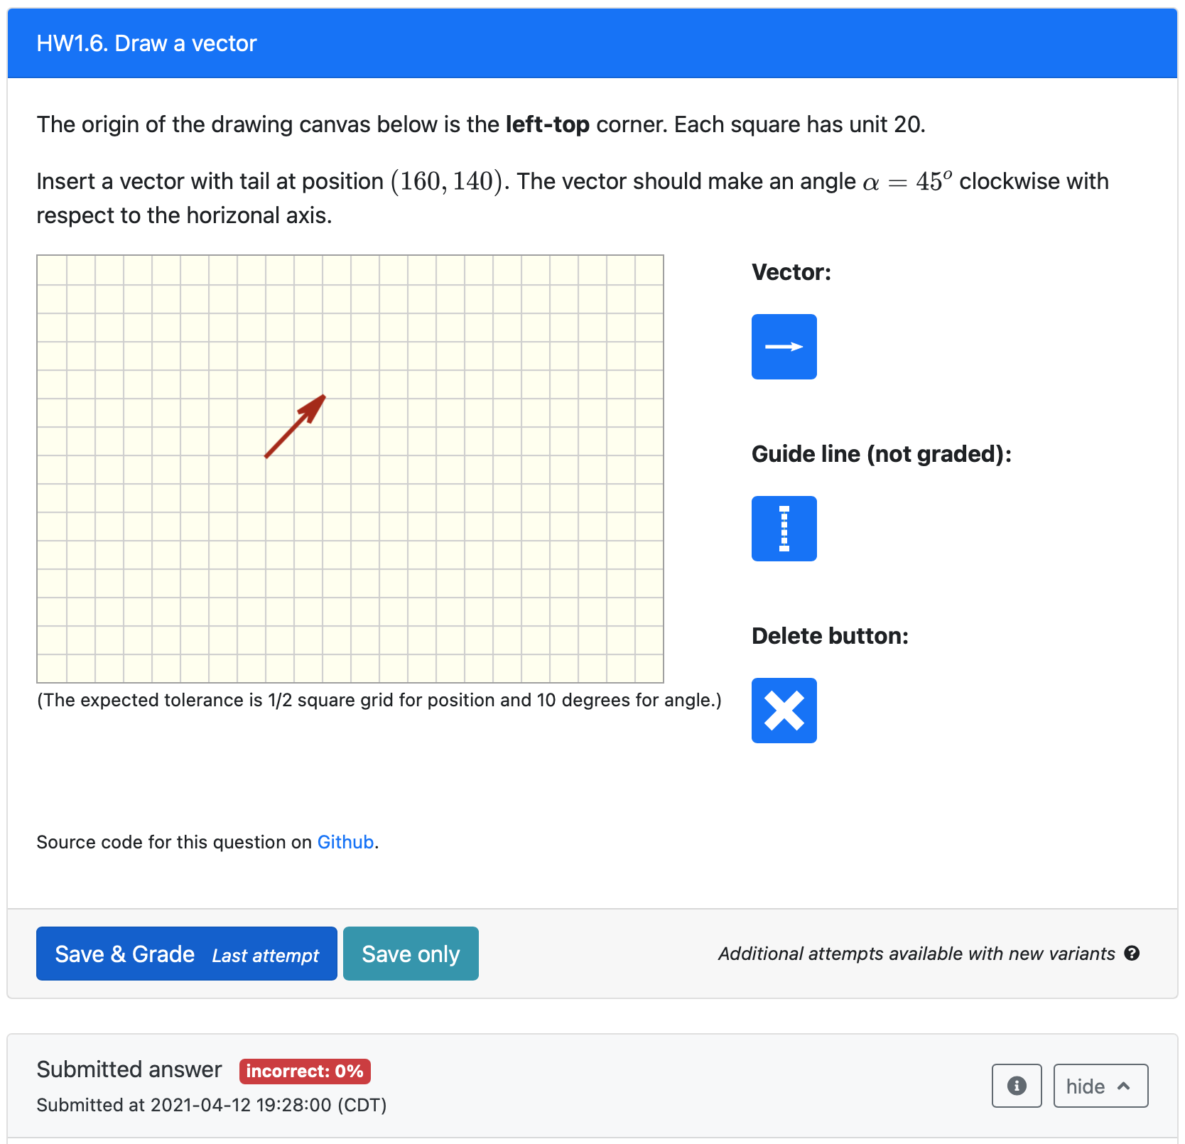

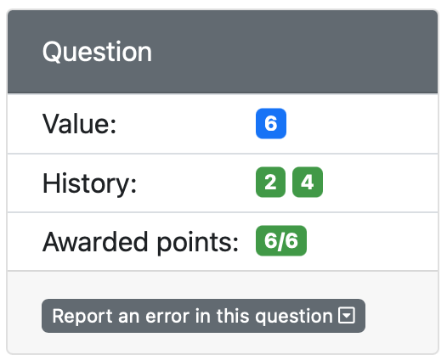
2nd attempt
This is the same question variant, but now with the correct submission
1st attempt
3rd attempt
Incorrect submission (angle should be clockwise).
Another question variant with correct submission
Student can still try another attempt of the same question (in this case, just rotate the vector)

Slide 8
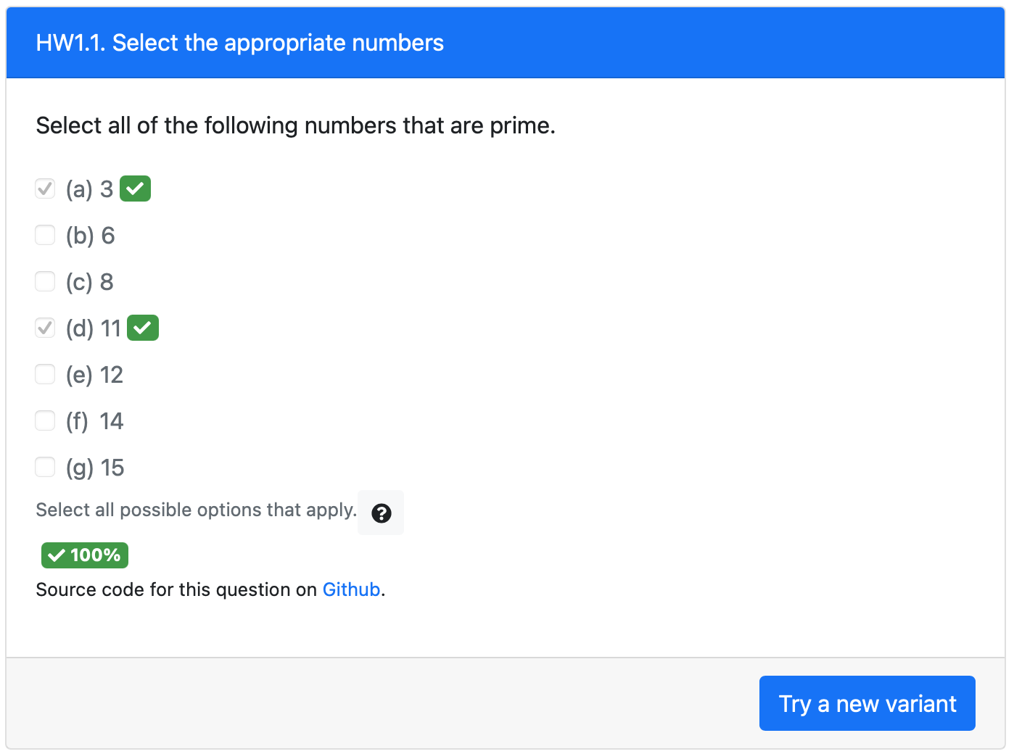
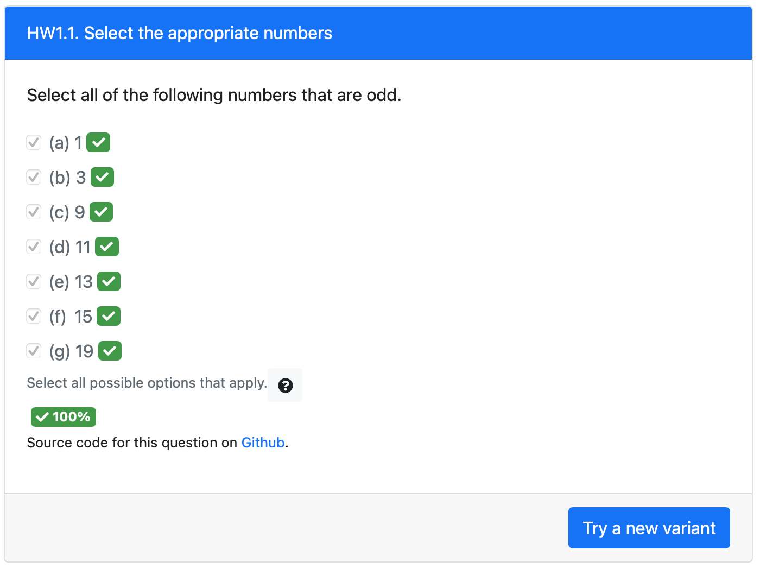
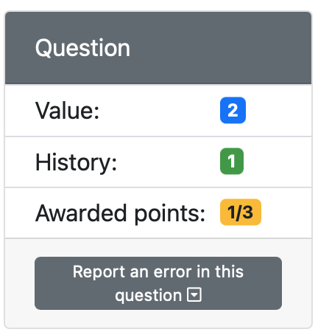
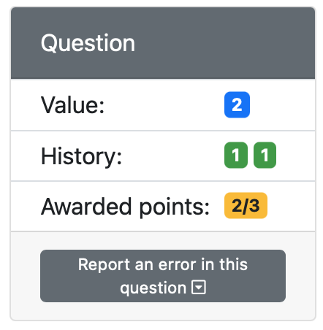
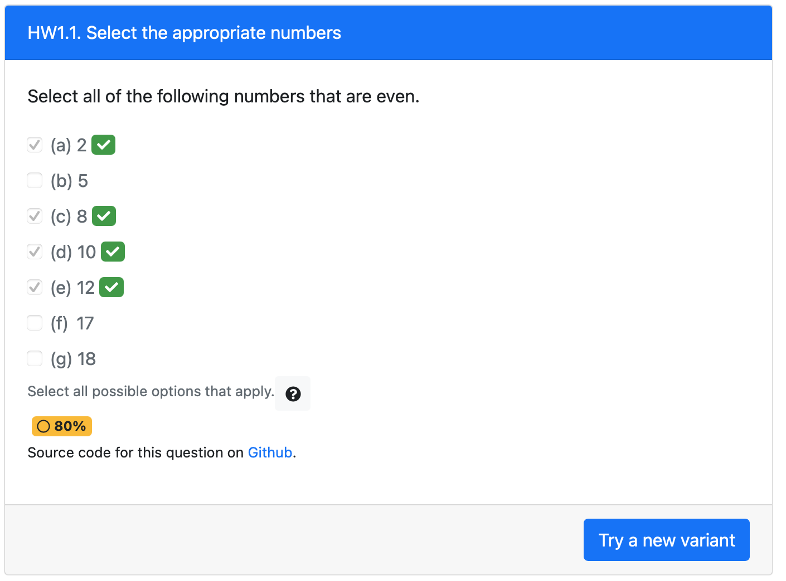
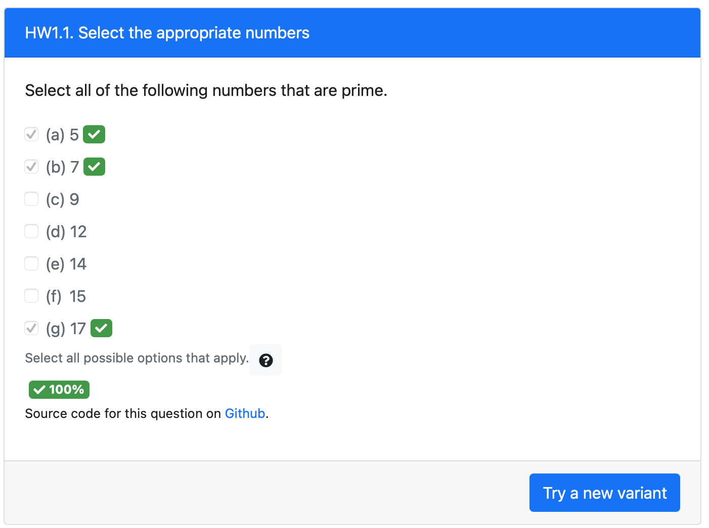
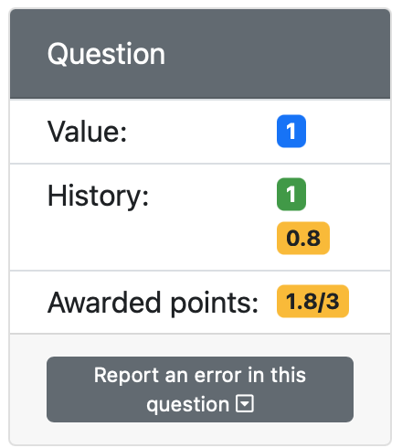
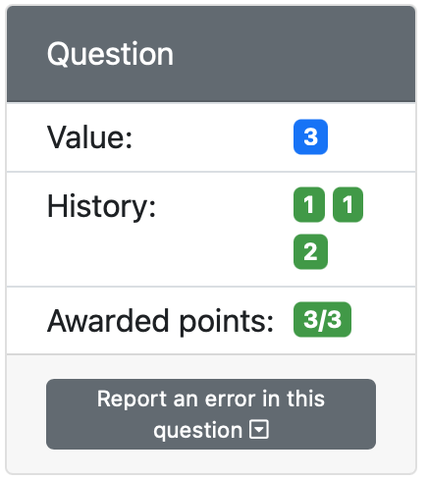
1st attempt
3rd attempt
Correct attempt completes the previous attempt that was still in-progress
This checkbox element uses a grading scheme with partial score
2nd attempt
4th attempt
Partial credit given to this attempt
Submission attempt still ”in-progress” (hence the yellow background). The next submission attempt will try to improve this score.

Slide 9
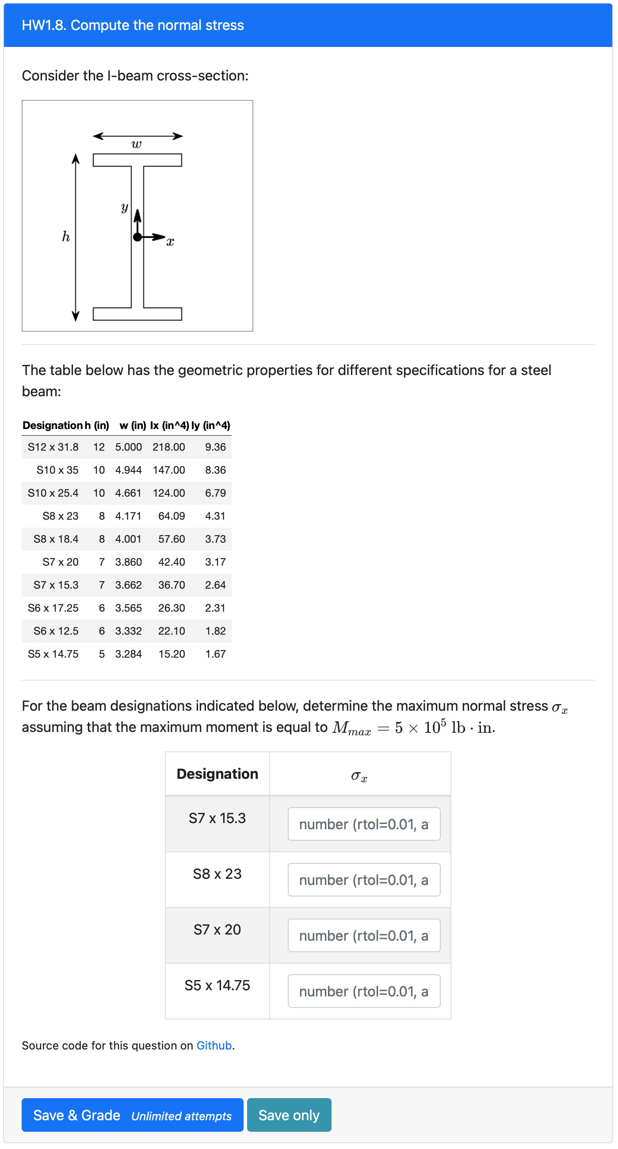
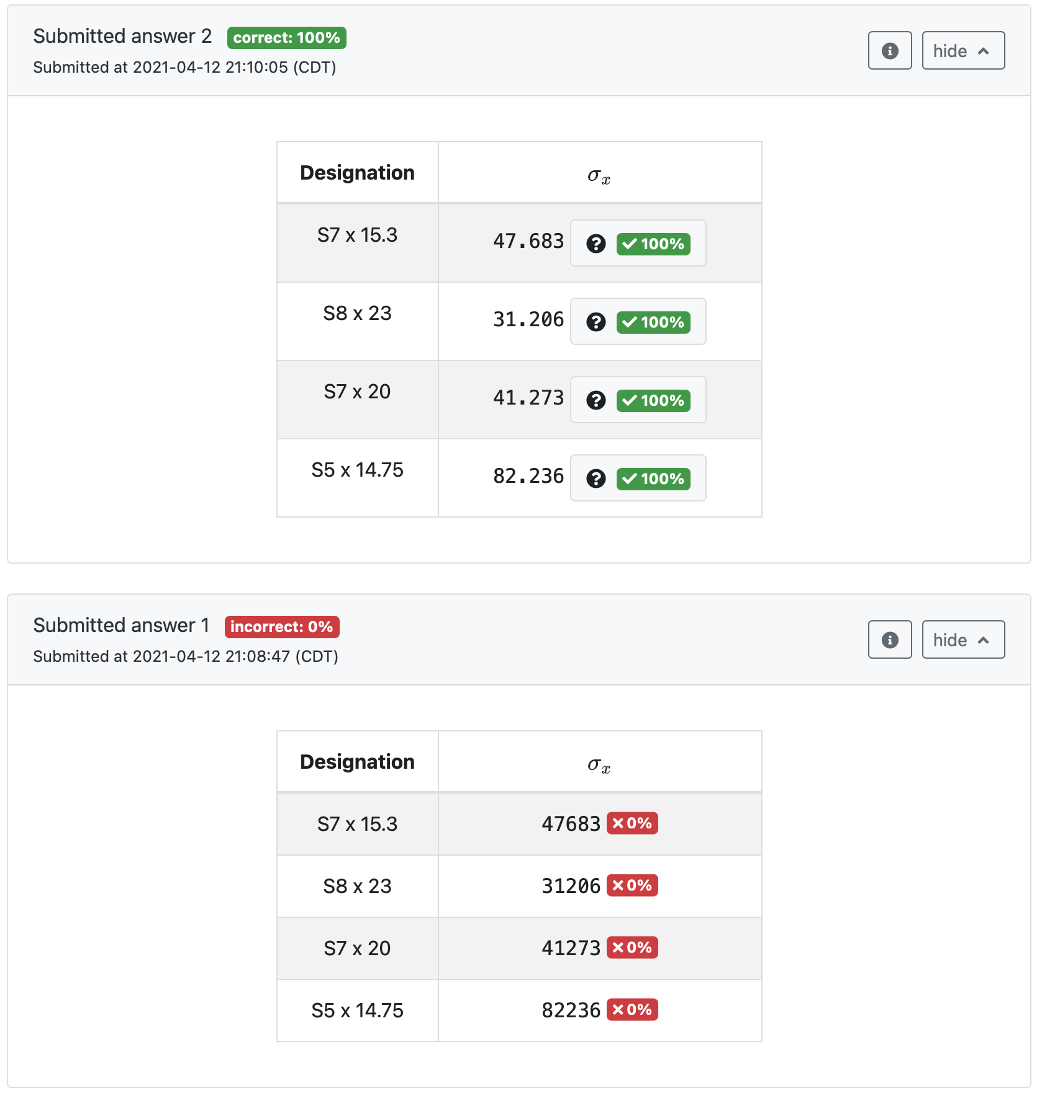
First attempt with incorrect answers (incorrect unit)
These parameters are randomized for each question variant, but with “singleVariant”: “true” they remain fixed for all unlimited attempts
Second attempt for the same question variant with the correct answers

